Slide 1
Solar cells
Equations
Programming
Applying to solar cells
- introduction + preliminary 1D calculation
- 1D analytical solution
- maximizing efficiency
- different types of solar cells

Slide 2
Solar cells
Equations
Programming
Applying to solar cells
- introduction + preliminary 1D calculation
- 1D analytical solution
- maximizing efficiency
- different types of solar cells

Slide 3
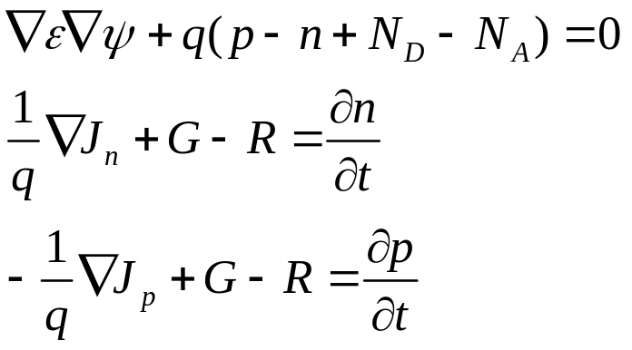
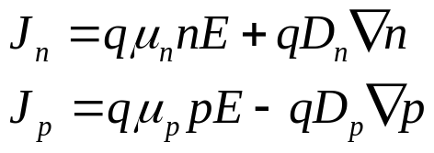
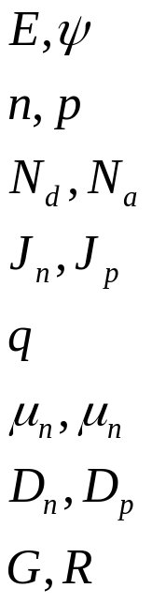
Basic semiconductor equations
Poisson equation
Continuity
equations
Electric field and potential
Electron and hole density
Ionized donors and acceptors concentration
Electron and hole current
Elementary electronic charge
Electron and hole mobility
Electron and hole diffusion coefficient
Generation and recombination rate

Slide 4

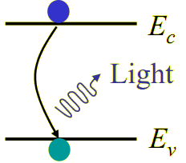
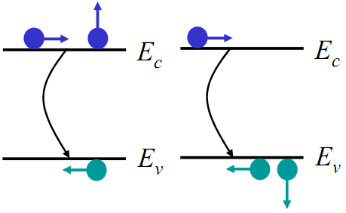

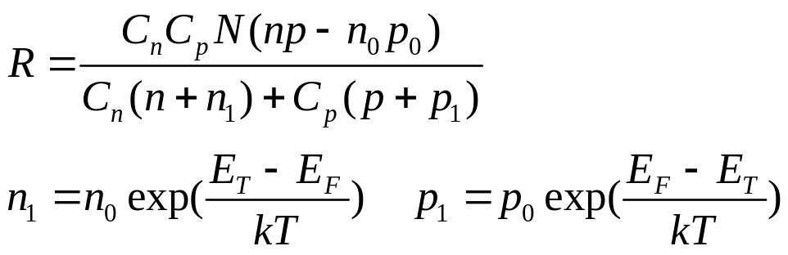
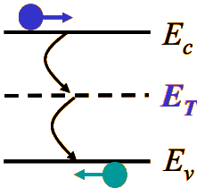


Recombination
Radiation recombination
Auger recombination
Recombination through deep defects level
Equilibrium electron and hole density, defined by
Others - constants defined by medium

Slide 5
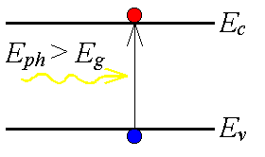
Generation
- absorbed photon with energy larger than band-gap produces one electron-hole pair
- absorption can be calculated by independent electromagnetic simulation
(Gui, give me picture!)

Slide 6
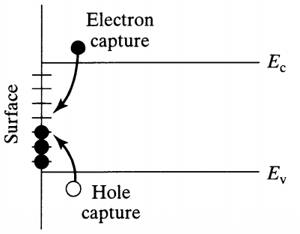

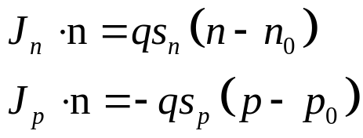
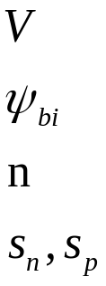


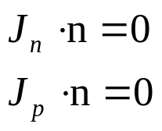
Boundary conditions
Semiconductor - metal
applied voltage
built-in potential, defined by
normal to the boundary (to inside)
electron and hole surface recombination velocity
If surface recombination velocity is infinite, then
Semiconductor - dielectric

Slide 7
Extended models
Bandgap narrowing
More sophisticated models for recombination
Mobility dependence on temperature and doping density
Incomplete ionization model
etc.

Slide 8
Solar cells
Equations
Programming
Applying to solar cells
- introduction + preliminary 1D calculation
- 1D analytical solution
- maximizing efficiency
- different types of solar cells

Slide 9
… - C++ program for 3D semiconductors simulations
Motivation:
- there is no open 3D code
- need to substitute absorption distribution calculated by independent electromagnetic simulation
Possibility to easily include:
- various type of meshes (using C++ templates strategy)
- arbitrary physical models (using C++ virtual functions strategy)

Slide 10
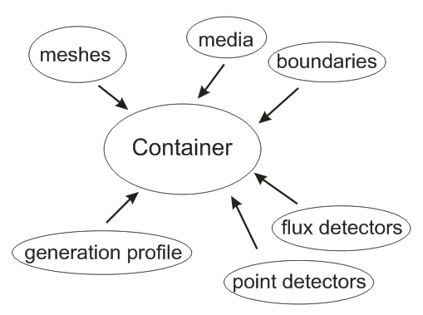
Easy C++ interface for experiment setting
Arbitrary number of different type meshes can be used at the same time (now only rectangular mesh is implemented).
Meshes intersection - higher priority mesh is used
Values on detectors are interpolated by meshes
For flux detector setting only surface should be specified

Slide 11
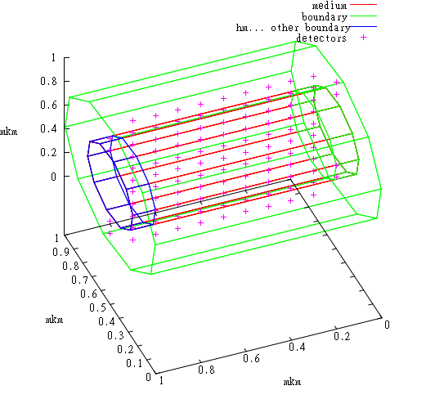
Geometry can be showed by gnuplot or paraview

Slide 12
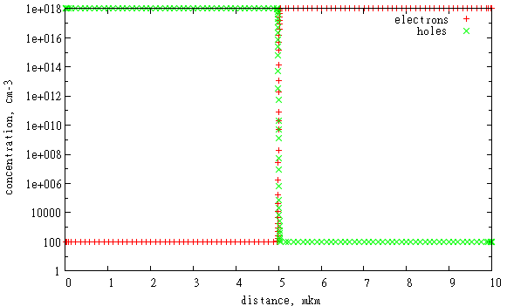
Arbitrary mesh step along coordinate axis
pn-junction: mesh step becomes smaller close to
- border between p- and n- layers (5 mkm)
- contacts (0, 10 mkm)

Slide 13
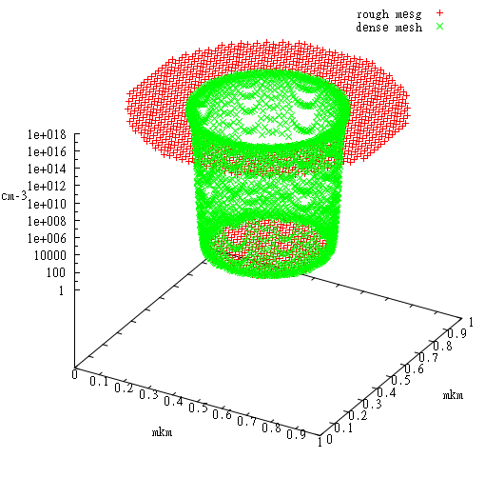
Multi-grid approach
cylindrical pn-junction:
additional dense mesh is used at the border between p- and n- layers (r=0.5 mkm)
- mesh border points are interpolated by neighboring meshes
- mesh memory is reserved only for working area

Slide 14


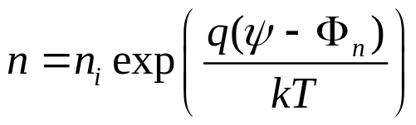
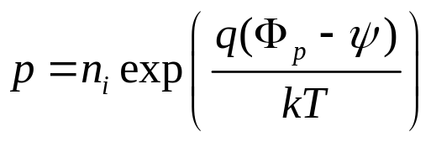

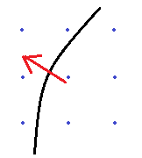
Numerical scheme
Scaling for length, time, energy, concentration
Choosing independent variables: or
Quasi-Fermi levels for electrons and holes
Discretization:
Poisson equations – straightforward
Continuity equations - Scharftter–Gummel approximation
Dirichlet and Neumann boundary conditions for curved surfaces

Slide 15
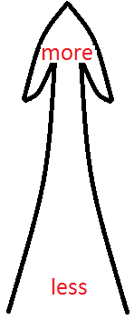
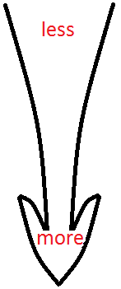
Solution technique
variables
system of equations
calculation speed
accuracy
Linear (system of equations)
for Poisson and Continuity
Linearized for Poisson and linear for Continuity
Nonlinear for Poisson and linear for Continuity
Nonlinear for Poisson and Continuity
Nonlinear for Poisson + Continuity
- using (n,p) variables is less accurate
- ignoring nonlinearity in recombination term is less accurate
- nonlinear systems solving is slower
- solving Poisson and Continuity at the same time is slower

Slide 16
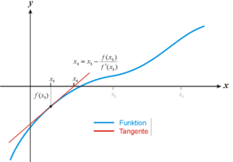
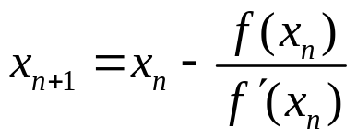





Newton-Raphson method
One-dimensional case
Multi-dimensional case
- Jacobian matrix
- using clamp ( )
- can be decreased until new residue value becomes smaller than previous

Slide 17
High efficiency
Incorporated timers allow to measure time consumed by each procedure.
They show that the most time consuming is PARDISO
PARDISO library is used for solving system of linear equations (10 faster than LAPACK)
- Each mesh type provides optimized scheme for matrix elements calculating
- Intermesh matrix elements are calculated using general mesh-independent algorithm

Slide 18
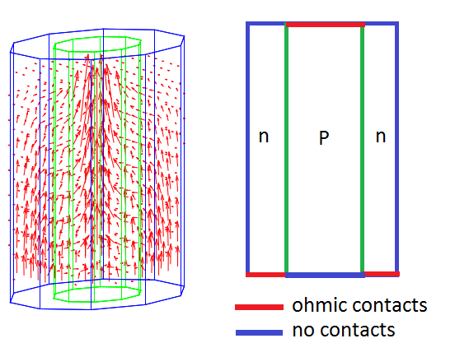
Calculated photocurrent distribution in Si nanowire
doping concentration = 10¹⁶ cm-3
radius = 250nm
height = 500nm
illumination - uniform along the whole nanowire.
(height / radius radio at the picture is not preserved)

Slide 19
Solar cells
Equations
Programming
Applying to solar cells
- introduction + preliminary 1D calculation
- 1D analytical solution
- maximizing efficiency
- different types of solar cells

Slide 20
Solar cells
Equations
Programming
Applying to solar cells
- introduction + preliminary 1D calculation
- 1D analytical solution
- maximizing efficiency
- different types of solar cells

Slide 21
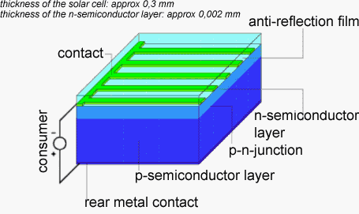
Solar cell

Slide 22
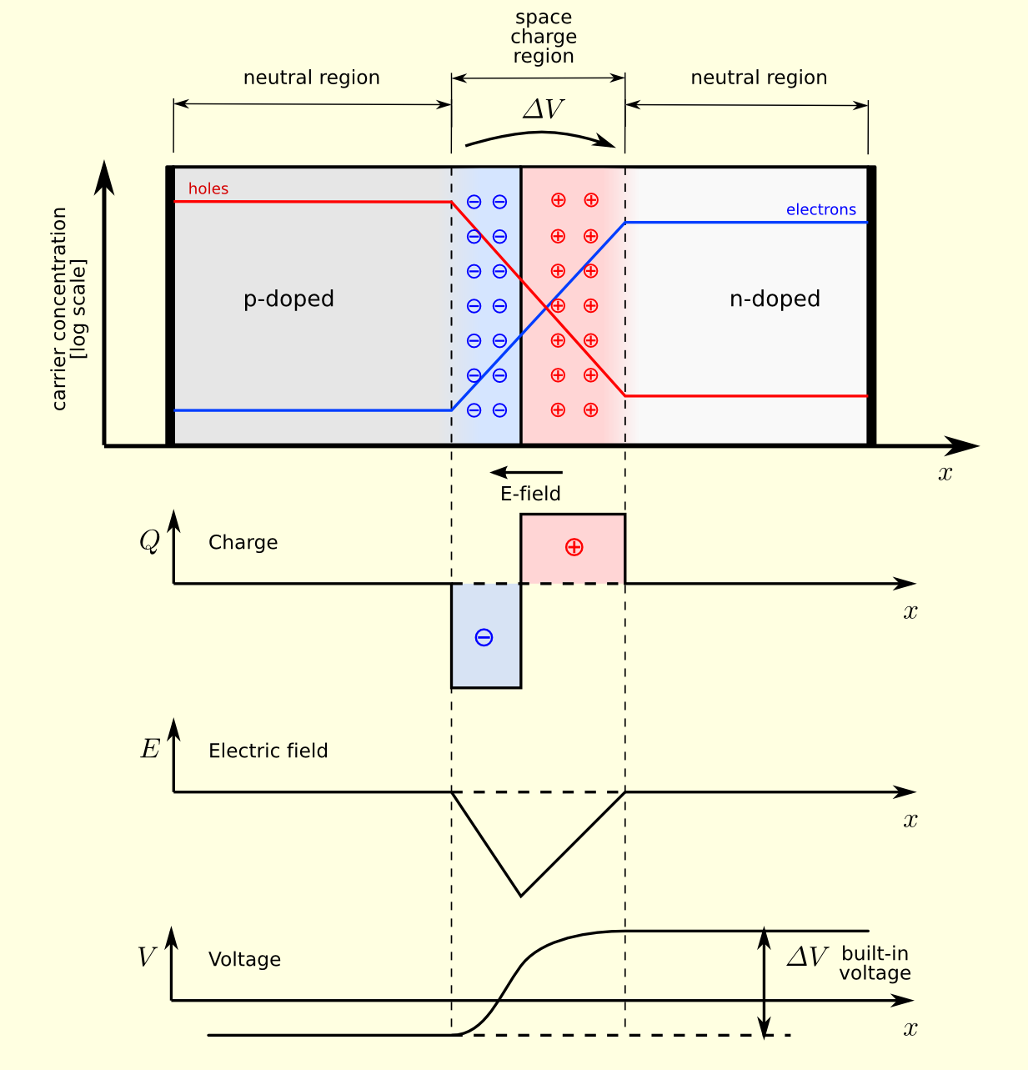
pn-junction

Slide 23
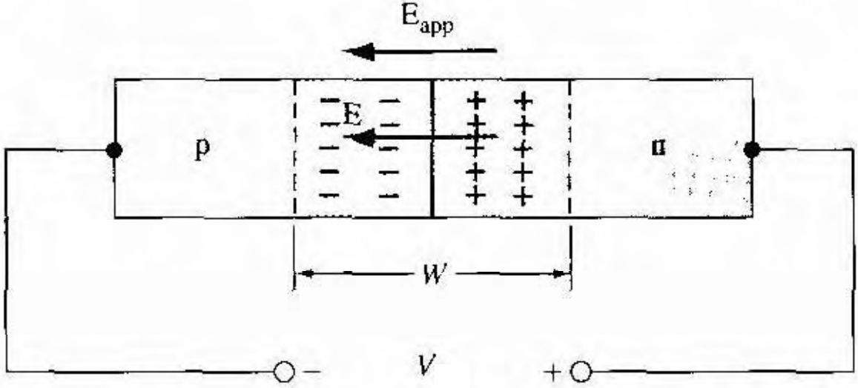
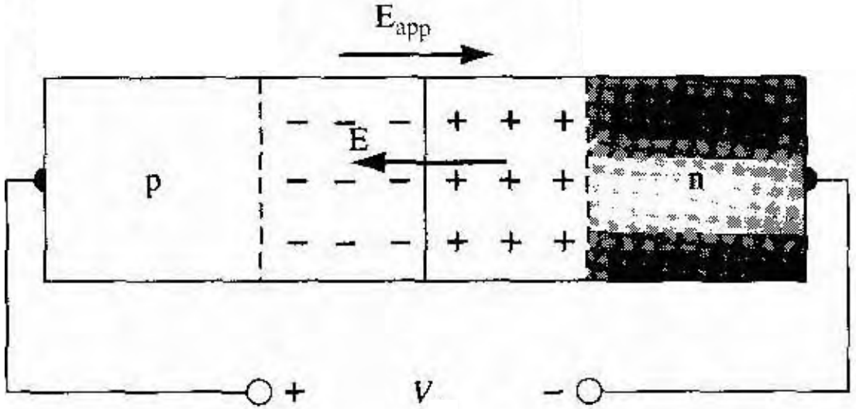
pn-junction conducts current in one direction
reverse-bias: bad conductivity
forward-bias: good conductivity

Slide 24
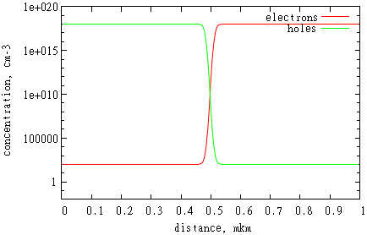
Simulation results
silicon pn-junction
- width 1mkm
- doping concentration 1e18 cm-3
- infinite surface recombination

Slide 25
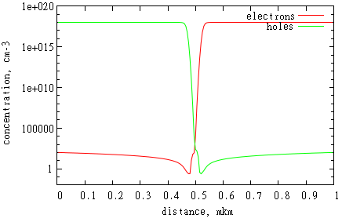
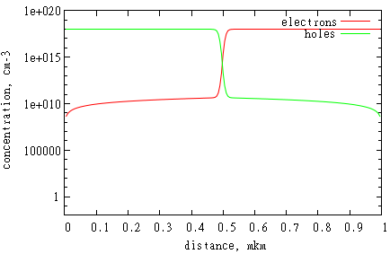
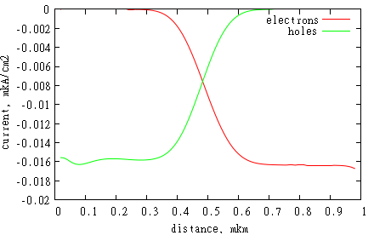
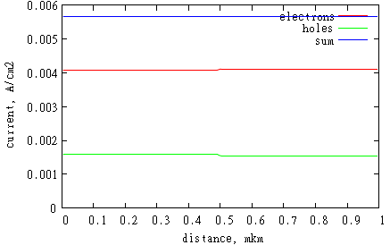
Voltage is applied
reverse-bias (-1V)
forward-bias (0.514V)

Slide 26
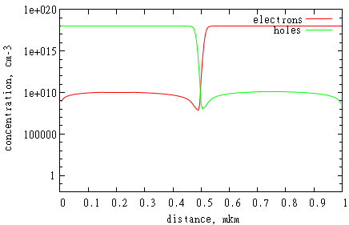
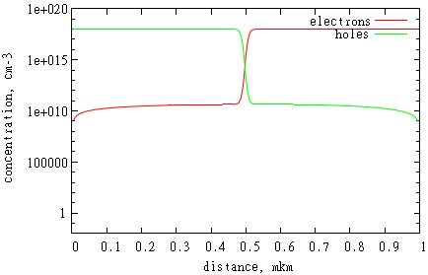
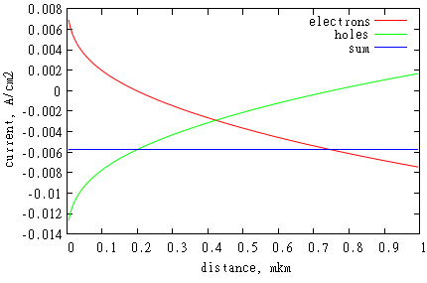
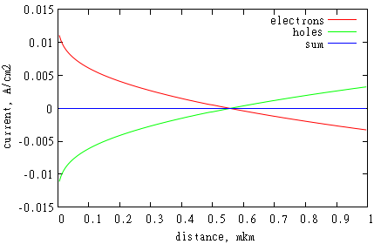
Under illumination (AM1.5)
short-circuit
open-circuit (0.514V)

Slide 27

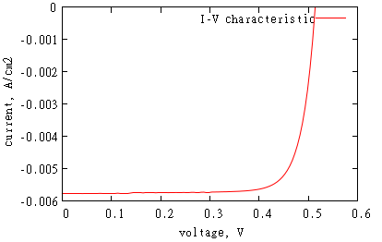
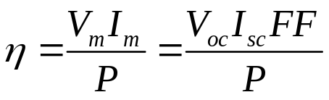




Efficiency
peak power
short circuit current, open circuit voltage
current and voltage at maximal power
fill factor
incident light power
efficiency

Slide 28
Solar cells
Equations
Programming
Applying to solar cells
- introduction + preliminary 1D calculation
- 1D analytical solution
- maximizing efficiency
- different types of solar cells

Slide 29
1D analytical solution. Assumptions
Depletion and quasi-neutral regions assumption.
depletion region:
- current is small difference between drift and diffusion terms
- depletion region so is small that current is constant
quasi-neutral region:
- minority carriers have a much lower concentration than majority carriers
- electric field is zero

Slide 30
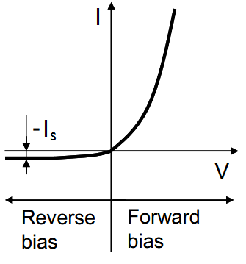
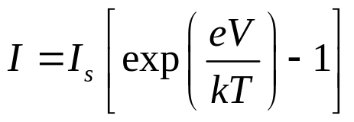
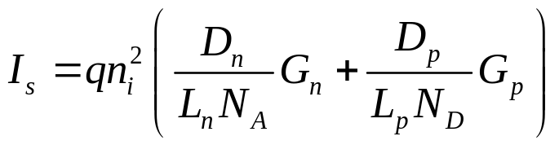
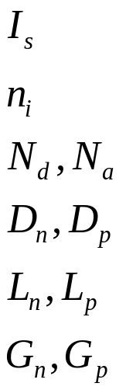

1D analytical solution. Results
saturation current
intrinsic carriers concentration (is higher if band gap is lower)
ionized donors and acceptors concentration
electron and hole diffusion coefficient
electron and hole diffusion length
geometry factors, defined by width of quasi-neutral region, diffusion coefficient and length, surface recombination

Slide 31
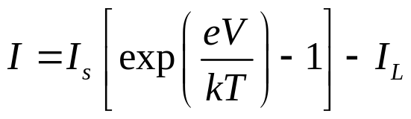


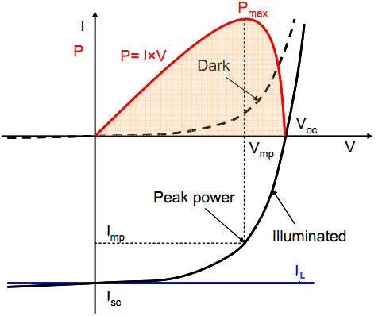

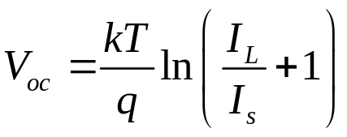


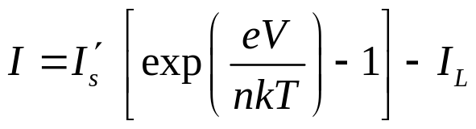

Under illumination
in the case of uniform generation rate G
photocurrent
depletion region width
short circuit current
open circuit voltage
more rigorous analysis:
ideality factor

Slide 32
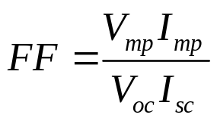
Efficiency
current and voltage at peak power
fill factor
incident light power
efficiency

Slide 33
Solar cells
Equations
Programming
Applying to solar cells
- introduction + preliminary 1D calculation
- 1D analytical solution
- maximizing efficiency
- different types of solar cells

Slide 34



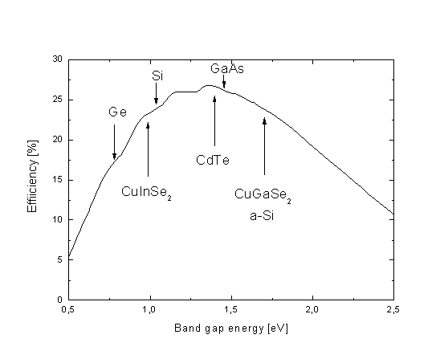
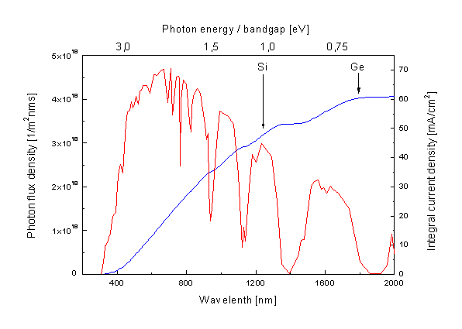
Band gap
because amount of used photons decreases increases
because saturation current decreases
maximal current for AM1.5 illumination
efficiency limits for AM1.5 illumination

Slide 35


Doping level
because mobility and diffusion length decrease
because saturation current decreases
Common parameters for silicon solar cell:
front n-layer – 10¹⁸ cm-3
back p-layer – 10¹⁶ cm-3
electron mobility versus donor density for Si

Slide 36





Bulk and surface recombination
because collection probability increases
because saturation current decreases
because ideality factor decreases to 1
collection probability is the probability that a generated carrier will contribute to the current

Slide 37


Geometry
Common parameters for silicon solar cell:
front n-layer – several microns
back p-layer – 100 - 1000 microns

Slide 38

Resistance
series resistance:
- bulk semiconductor
- contacts
shunt resistance:
- defects in the depleted region
- leakage current around the edges of the cell

Slide 39




Bulk semiconductor resistance
1 – n layer
2 – pn-junction
3 – p layer
4 – bottom contact
5 – top contact

Slide 40


Effect of series and shunt resistance

Slide 41


Module of solar cells
N number of sells in series
M number of cells in parallel
I_{sc} short circuit current from a single cell
V_{oc} open circuit voltage from a single cell

Slide 42
Solar cells
Equations
Programming
Applying to solar cells
- introduction + preliminary 1D calculation
- 1D analytical solution
- maximizing efficiency
- different types of solar cells

Slide 43

Solar cells generations
Generation I - silicon
Generation II - thin films (Si, a-Si, CdTe, organic etc.)
Generation III - multijunctions, intermediate bands, hot electrons, multiple electron-hole pairs, upconversion, downconversion

Slide 44

Generation III purpose
The fraction of AM1.5 illumination that can be converted into a usable energy by Si solar cell

Slide 45





Nanorods - orthogonalizing of absorption and carrier transport
cell thickness
diffusion length
absorption coefficient
B. Kayes etc., J. Appl. Phys. 7, 114302 (2005)

